Slide 1
Final Year Project Pitch
Project Title:
Student Result Management System with Digital Notice Board

Slide 2
Why this project?
After a lot of brainstorming, rejections, and research, I decided to combine two meaningful academic tools into one simple product. Instead of just doing a desktop app, this web-based system solves two major needs in colleges:
Publishing and viewing student results
Sharing important announcements

Slide 3
What does it do?
This system lets the admin:
Add and manage student records
Add subject-wise results for each student
Post digital notices like exam dates, holidays, events, etc.
And allows students (or visitors) to:
View public announcements
See their academic results

Slide 4
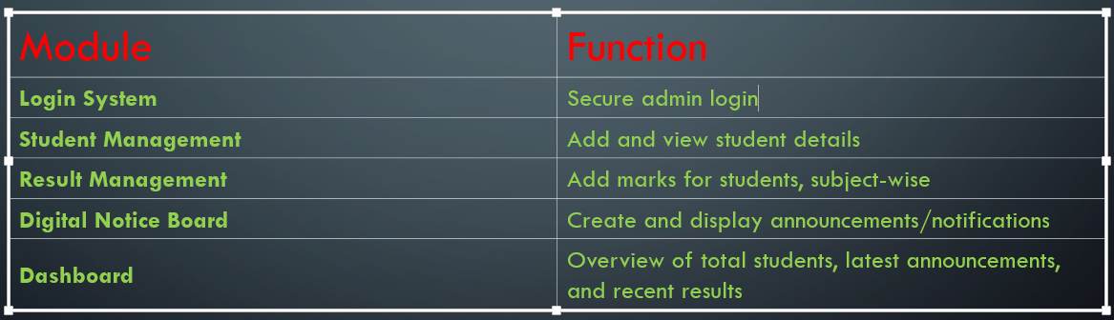
Modules in the System

Slide 5
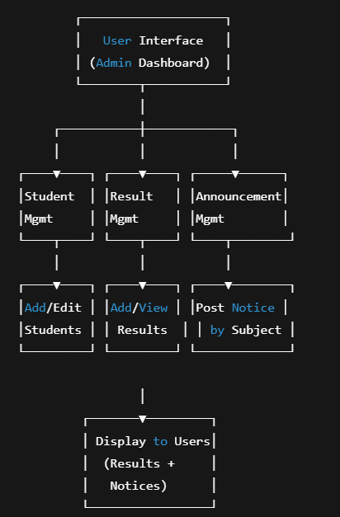
Workflow Diagram (Simple Flow)

Slide 6
After facing multiple rejections and feedback, I wanted to build something that is both useful and realistic to implement within our timeline. So I combined two systems that every college uses:
A Student Result Management System.
A Digital Notice Board System.

Slide 7
In this workflow, the admin (usually a teacher or college staff) logs into the system and can do three things from the dashboard:
Add or edit student records.
Upload subject-wise results for each student.
Post digital notices such as exam routines, holidays, or announcements.

Slide 8
These updates are automatically shown to users (students or viewers) on the front-end — meaning the system becomes a central place to access results and important updates.
The backend uses a simple PHP + MySQL stack, which keeps the structure light and manageable. I’ve already built the database part, and I’m working on connecting the results and announcement posting features next.

Slide 9
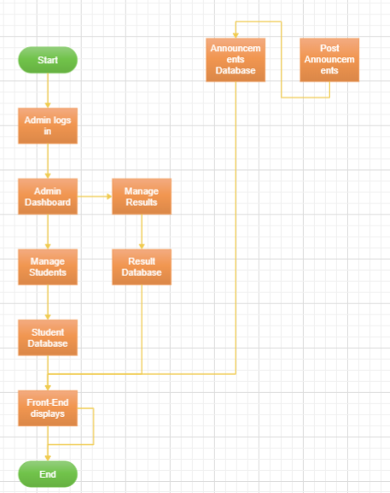
Flowchart

Slide 10
Project Value
Practical for schools and colleges
Saves paperwork and time
Centralized, organized info access
Can be easily upgraded (student login, PDF export, etc.)

Slide 11
Tech Stack
PHP
MySQL
HTML/CSS/Bootstrap
Hosted on XAMPP/Localhost

Slide 12
Current Progress
NONE

Slide 13
How You Can Pitch It (Say This Naturally)
“After trying multiple ideas, I settled on a combination system: a Student Result Manager + Digital Notice Board. It's simple, practical, and useful for academic institutes. I’ve already created the database and now I'm working on the web part using PHP. It helps admins post results and announcements in one place, making communication easier and faster."

